Slide 1





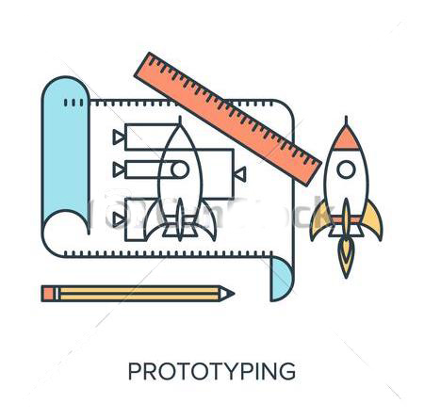
Personas
Storyboarding
Horizontal
Vertical
Prototyping
Demo
Notes:
Personas
Storyboarding
Horizontal x Vertical Prototyping
Demo

Slide 2



Narong Mongkut
Occupation : Engineering Student
Nationality : Thailand
Age : 25
Gender : Male
Language : Thai - native, English - good
Motivation / Description :
Always wanted to learn a foreign language to complement my studies however most people in Thailand only actively speak Thai and it becomes increasingly more difficult to master a foreign language.
Goal :
Always wanted to be an all rounded engineering graduate with not only focus in technical knowledge, however also other language skills that open international doors.
Pain points :
Doing exchange in Germany but do not know how to find resources to mingle with local students for language exchange.

Slide 3

Maxwell Bauer
Occupation : Hospitality Student
Nationality : USA (Miami, Florida)
Age : 26
Gender : Male
Language : English - native, French - good, Spanish - beginner
Franziska Hintermaier
Motivation :
Always wanted to study abroad and make new friends.
Goal :
Learning german, Collecting experiences for his studies and living in another culture
Pain points :
First time in Europe and not being familiar with it. Also not a frequent computer user.

Slide 4

Franziska Hintermaier
Occupation : Academic staff for Courses in English
Nationality : Germany
Age : 47
Gender : Female
Language : German - native, English - good
Franziska Hintermaier
Motivation/Description:
Have been working at the university since 20 years. Job mainly focusing on incoming international exchange students, helping them for courses registration and integration.
Goal :
To help international students have a pleasant stay in Munich.
Pain points :
Registration for CiE for foreign students is not very intuitive

Slide 5
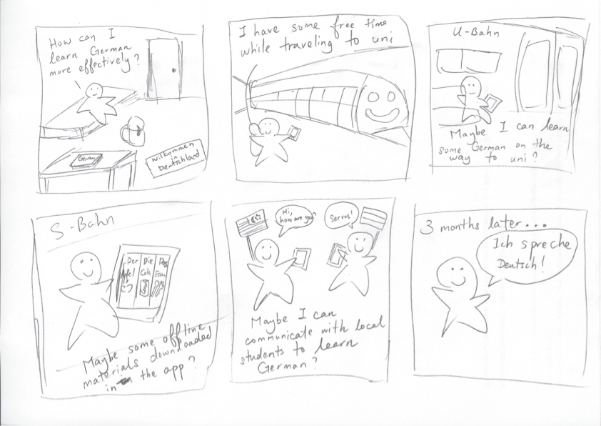


Slide 6
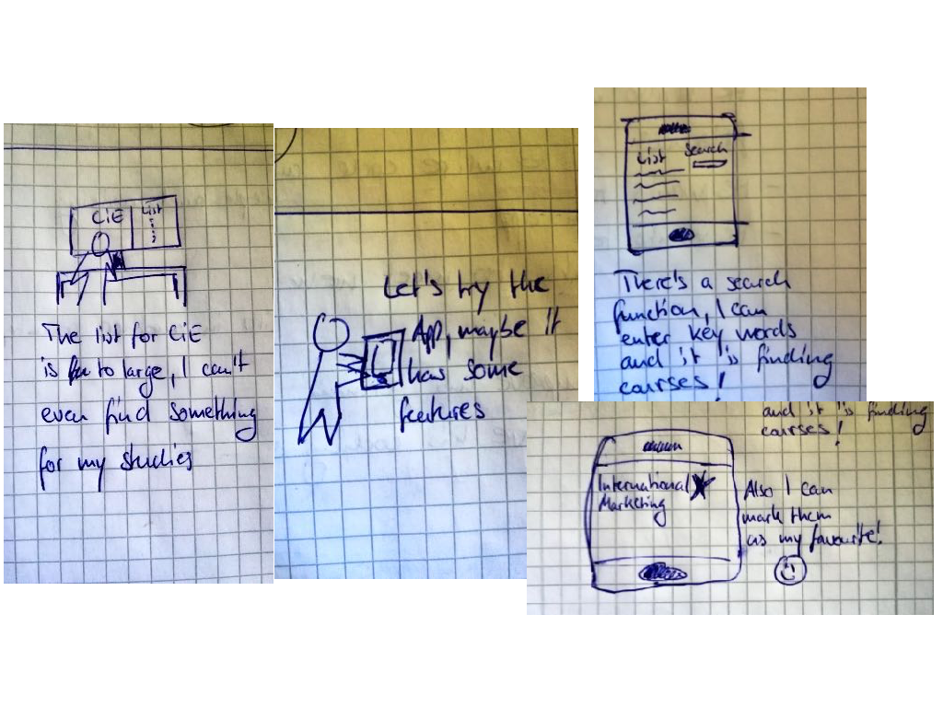

Slide 7
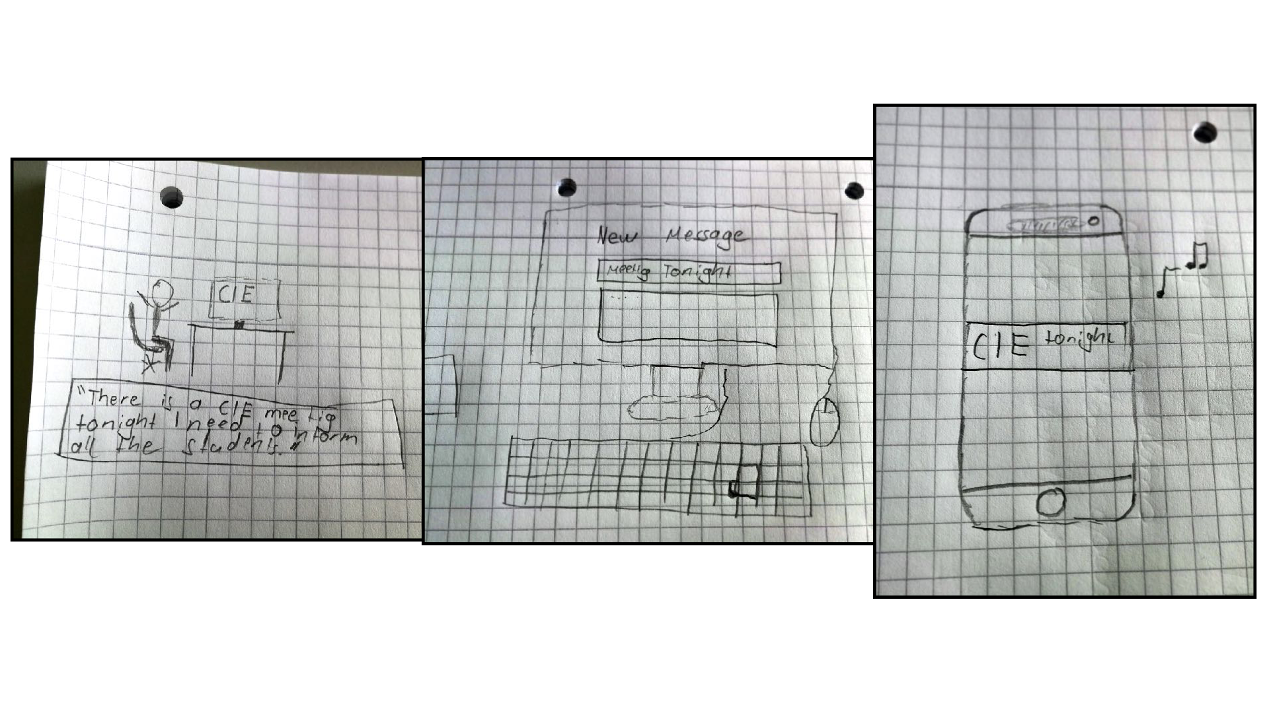

Slide 8


Horizontal Prototype
Users
Sign Up
Keep Track
Scroll
View
Campus/Location
Lecturers’ contact
Bookmark
Shopping cart
Sign up
Select classes
List
Timetable
CiEs from last semester

Slide 9
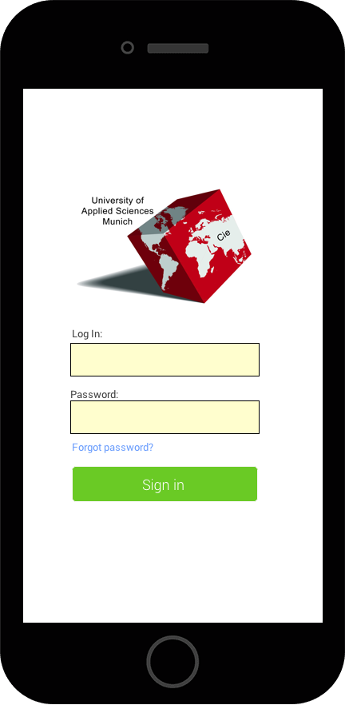
Sign Up

Slide 10
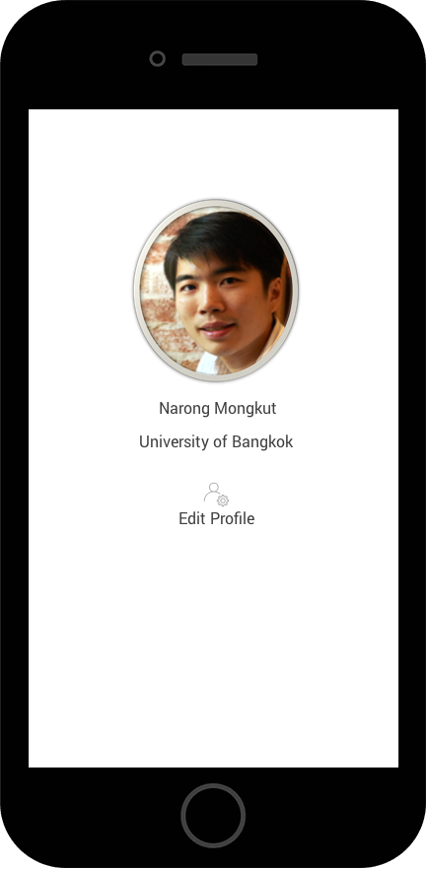
Keep Track
Timetable
List of current semester
CiE(s) taken last semester

Slide 11
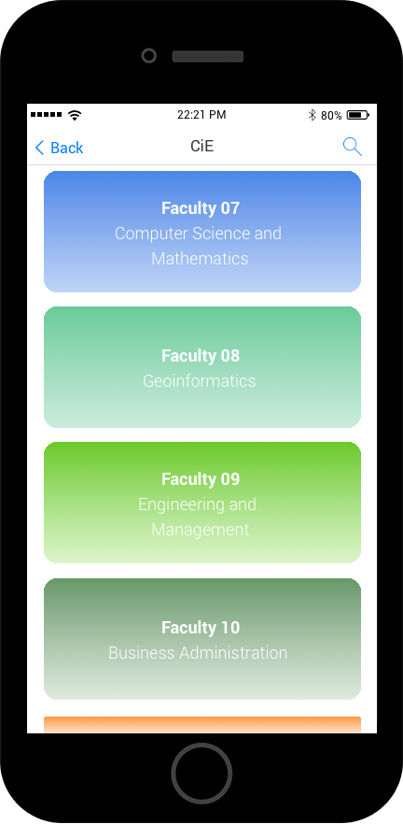
Scroll
View
faculties
sort by colours

Slide 12
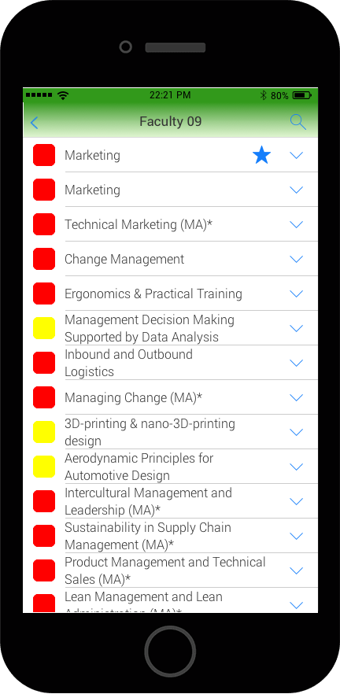
Scroll
View
Bookmark
added to cart
Select classes

Slide 13
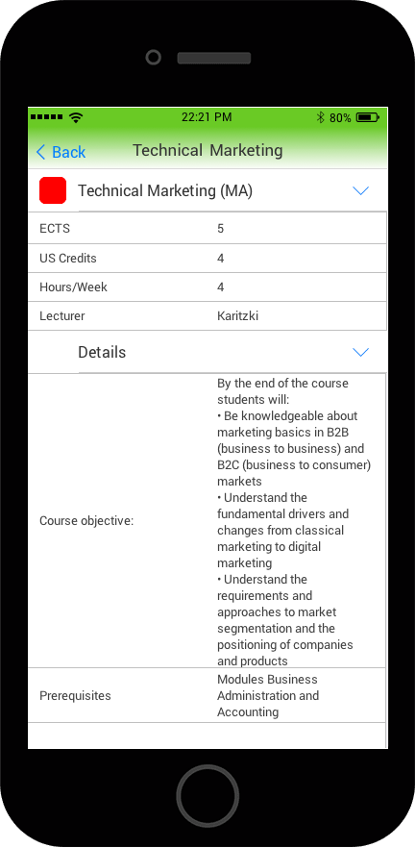
Scroll
View
with details
Campus/Location
- integrated map?
Lecturers’ contact

Slide 14
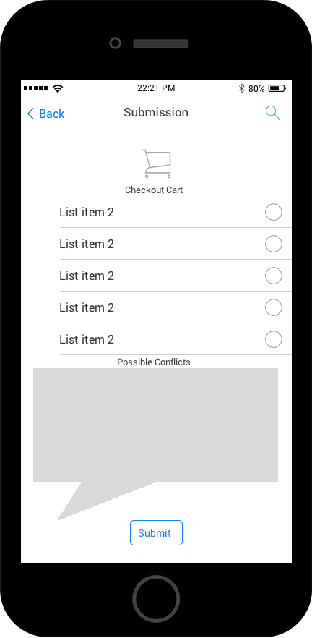
Shopping cart
Submission
Check for possible conflicts

Slide 15

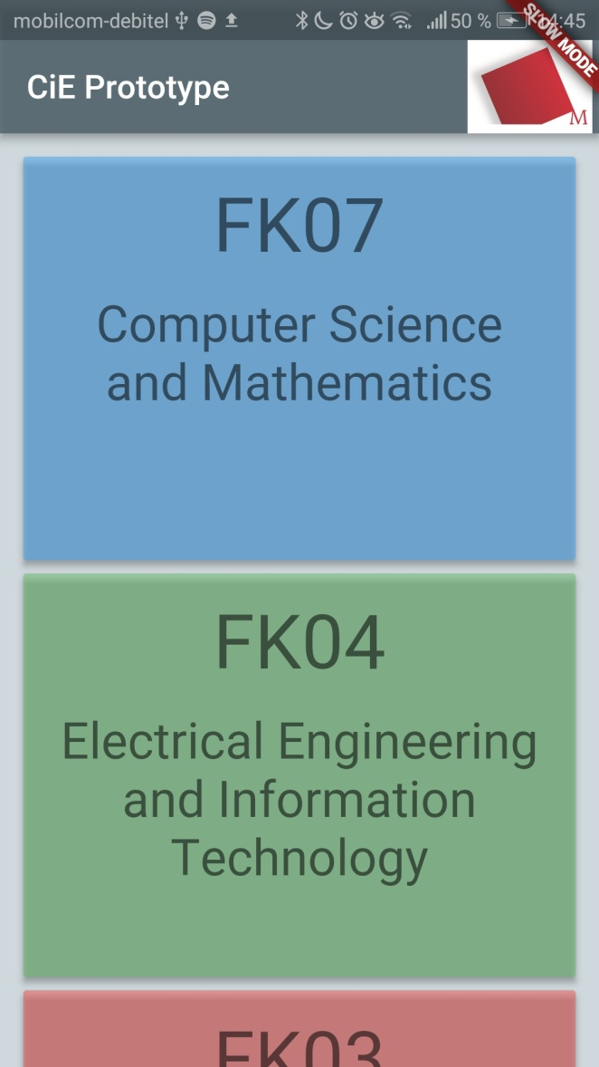
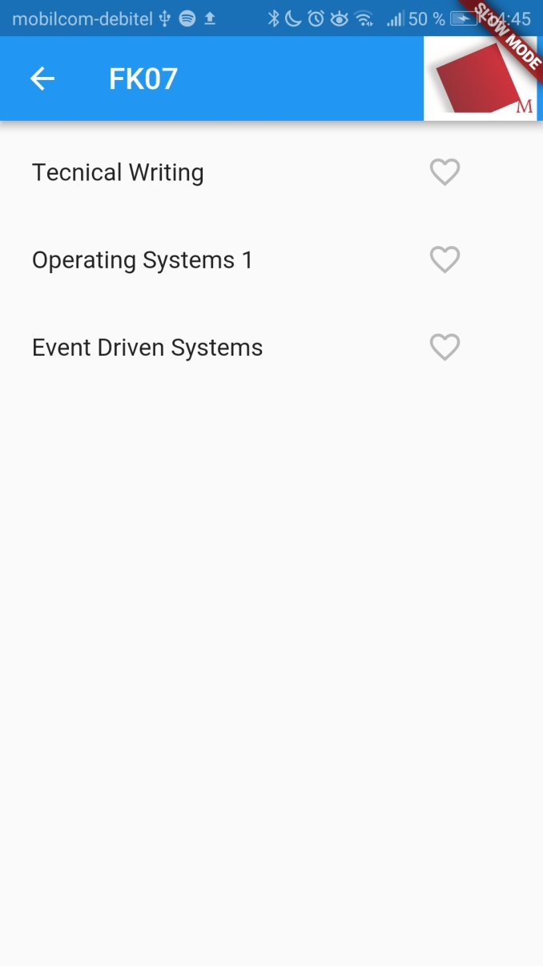
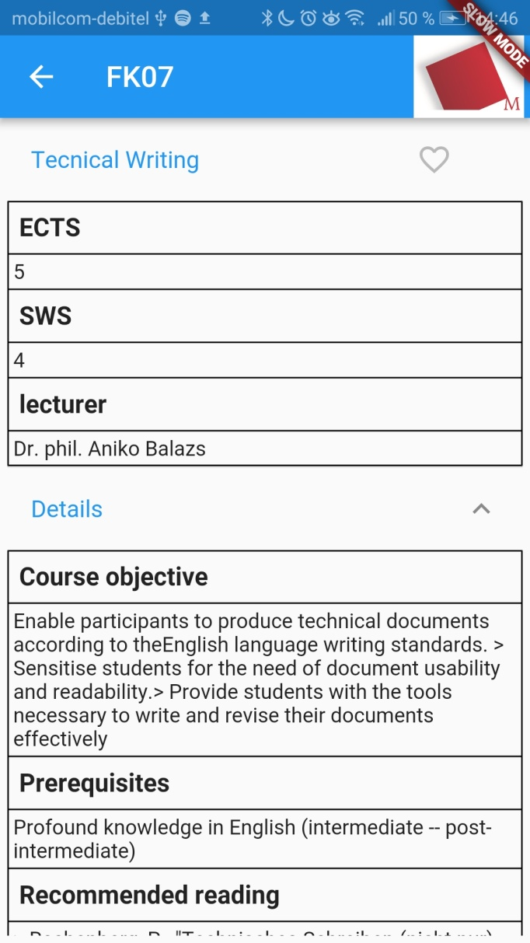
Vertical prototype

Slide 16
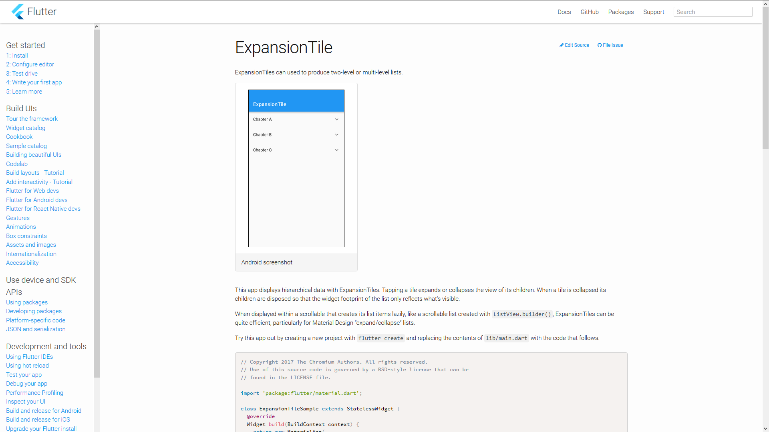

Slide 17
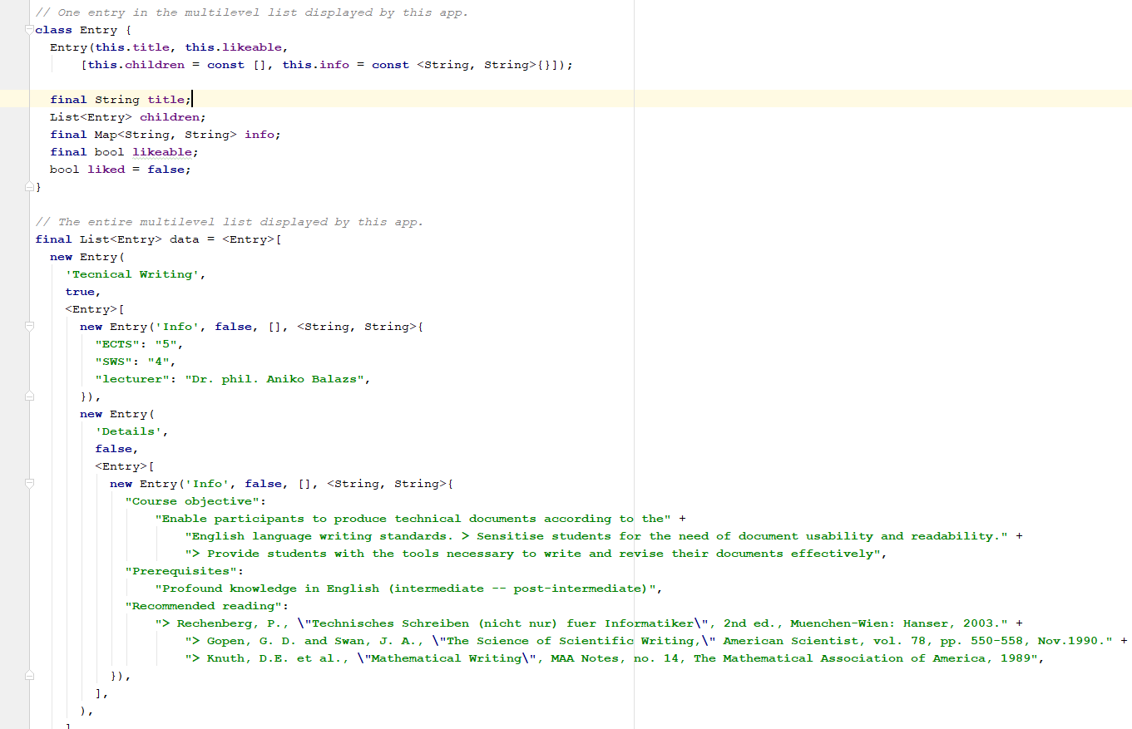
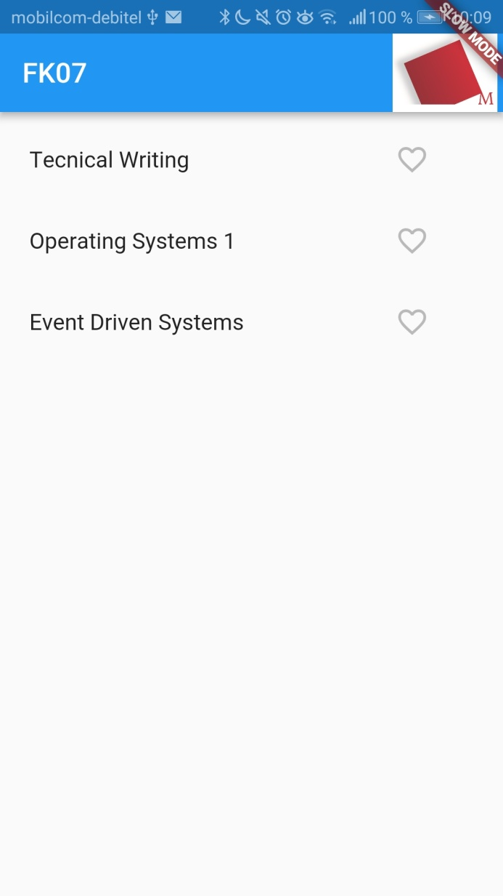

Slide 18
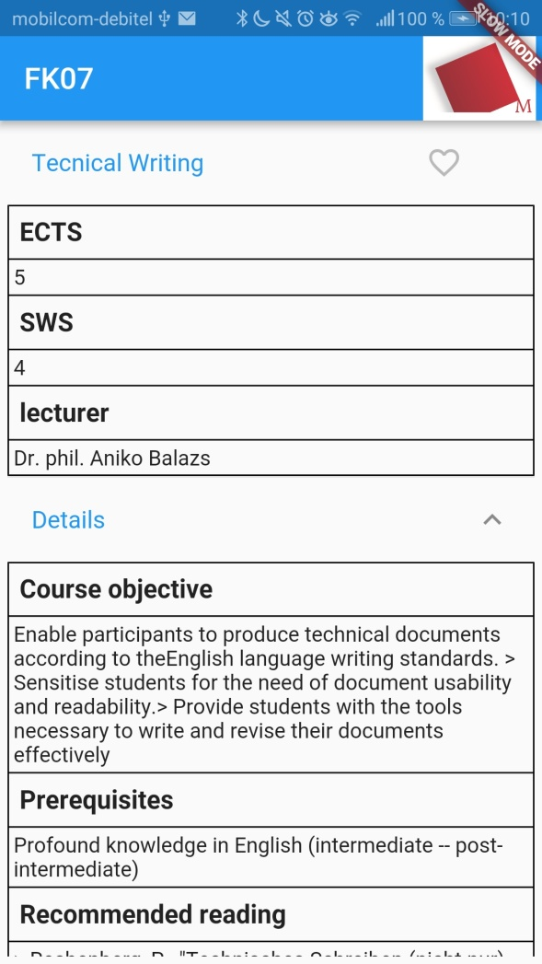

Slide 20
Demo

